Slide 1





THANK YOU
ALEXA TULLETT
SHARLA BIEFIELD
LEIF NELSON
WILL HART
DESPINA STAVRINOS

Slide 2
FROM MISCONDUCT TO REFORM: UNDERSTANDING PERCEPTIONS OF THOSE WHO COMMIT AND CALL OUT QUESTIONABLE RESEARCH PRACTICES
By Savannah C. Lewis

Slide 3
AGENDA
Background
Research Questions
Methods
Plan Analyses
Feedback

Slide 4
BACKGROUND
Studies show 50–96% of researchers have engaged in at least one QRP.
QRPs reduce scientific credibility and reproducibility.
Not All QRPs Are Equal
Perceptions of researchers differ
Investigator = those who commit QRPs
Inspector = those who report them
Notes:
Severe offenses like fraud lead to strong penalties (e.g., job loss).
Less severe practices often face no real consequences.
But we also see that the rating of severity may be confounded with the prevalence pr commonality of the QRP in the field.
Larsson et al. HARKing and Salami slicing being the most frequent and rated the lower in severity.
This inconsistency shapes perceptions of researcher in regards to trust, likeability, and a variety of reputationally aspects such as likelihood to get a job or secure funding.
Over 60% of whistleblowers report at least one negative consequence.

Slide 5
RESEARCH QUESTIONS
Research Question 1: How is trustworthiness influenced by role and QRP severity?
Research Question 2: How is likeability influenced by role and QRP severity?
Research Question 3: Is the perceived trueness of the finding influenced by QRP severity?
Notes:
Although trustworthiness and likeability are often positively related, prior work suggests they can diverge in contexts involving norm enforcement. For example, Monin, et al., (2008) found that “moral rebels (i.e. those who refuse to go along with moral questionable tasks) are judged as principled and trustworthy but also tend to be disliked. Similarly, Cheliatsidou et al. (2023) report that whistleblowers are recognized as upholding ethical standards yet are often seen as disloyal or disruptive. These findings suggest that inspectors may be evaluated as more trustworthy because of their integrity, but less likeable because their actions generate social tension.

Slide 6
THE CURRENT PROJECT IDEA
2 x 3 fully within-subjects design
Researcher vs QRPs Severity
Trust, Likeability, and trueness of the findings
Notes:
441 usable participants

Slide 7
Trust in Scientists (Cologna et al, 2025) (Shortened Subset by S. Lewis)
Response options varied for each item but are on a 5-point Likert Scale (e.g., 1 = very (unqualified), 2= somewhat (unqualified), 3 = neither (qualified) nor (unqualified), 4= somewhat (qualified), 5 = very (qualified).
Competence
How qualified or unqualified is researcher X when it comes to conducting high-quality research?
How qualified or unqualified is researcher Y when it comes to conducting high-quality research?
Benevolence
How considerate or inconsiderate is researcher X of others’ interests?
How considerate or inconsiderate is researcher Y of others’ interests?
Integrity
How ethical or unethical is researcher X?
How ethical or unethical is researcher Y?
Trustworthy
How trustworthy or untrustworthy is researcher X?
How trustworthy or untrustworthy is researcher Y?

Slide 8
Likeability scale (Reysen, 2005) (Shortened Subset by S. Lewis)
Response options varied for each item but are on a 5-point Likert Scale (e.g., 1 = very (unlikeable, 2= somewhat (unlikeable), 3 = neither (likeable) nor (unlikeable), 4= somewhat ( likeable), 5 = very (likeable).
Likeable
How likeable or unlikeable is researcher X?
How likeable or unlikeable is researcher Y?
Approachable
How approachable or unapproachable is researcher X?
How approachable or unapproachable is researcher Y?

Slide 9
Perceived trueness of the effect (Ebersole et al, 2016)
Response options varied for each item but are on a 5-point Likert Scale (e.g., 1 = very (untrue), 2= somewhat (untrue), 3 = neither (true nor (untrue), 4= somewhat (true), 5 = very (true).
The original effects
How true or untrue are the results of researcher X?

Slide 10
Attributes of researcher used in Ebersole et al, 2016:
Responses will be the selection of either Reported Researcher or Reporting Researcher.
Which researcher is smarter: Reported Researcher or Reporting Researcher?
Which researcher is more ethical: Reported Researcher or Reporting Researcher?
Which researcher is a better researcher: Reported Researcher or Reporting Researcher?
Which researcher is more creative: Reported Researcher or Reporting Researcher?
Which researcher would you rather be: Reported Researcher or Reporting Researcher?
Which researcher should you be: Reported Researcher or Reporting Researcher?
Which researcher is more like the most celebrated researchers: Reported Researcher or Reporting Researcher?
Which researcher is more like the typical researcher: Reported Researcher or Reporting Researcher?
Which researcher is more likely to keep a job: Reported Researcher or Reporting Researcher?
Which researcher is more likely to get a job: Reported Researcher or Reporting Researcher?

Slide 11
VIGNETTES
How we got them?
Structure
Notes:
Each participant will read six vignettes. The vignettes were created using scenarios from Ebersole and colleagues (2016) as a guide. Ebersole and colleagues used a similar study design to compare replicators and original researchers. The current project’s vignettes adopt this same structure, but instead of a replication, the second researcher conducts a robust check or review then reports their concerns to the original researcher’s institute. All vignettes begin with a sentence about Researcher X (the scientific investigator) and continue with a sentence about the QRP they engaged in. The third and final sentence describes Researcher Y (the scientific inspector) writing a blog post providing evidence of their suspicions of Researcher X with a suggestion on the implications of the QRP. For example, you can see the structure of the vignettes in our HARKing example;
Researcher X conducted a study and found an interesting result. However, when Researcher Y reviewed the paper, they realized that Researcher X had changed their hypothesis to fit with the data, presenting it as if it had been what they predicted all along. Researcher Y writes a blog post highlighting evidence that Researcher X changed the original hypothesis. Researcher Y suggests manipulating hypotheses after data collection can mislead the scientific community and undermine the integrity of research.
Vignettes vary by severity of QRP. There are two scenarios at each level: vague preregistration and overreaching abstract (minor), p-hacking and HARKing (moderate), salami slicing and data fabrication (major). Severity was informed by a combination of theoretical and empirical sources. Kolstoe’s (2023) spectrum of QRPs conceptualizes QRPs as a continuum, from minor error to misunderstanding, sloppiness, incompetence, falsification, fabrication, and ends with criminal misconduct. Accordingly, vague preregistration and overreaching abstract were classified as minor, as they represent misunderstanding or sloppiness.
To determine moderate and major QRPs, Bottesini et al., (2022) evidence was used. They found that HARKing and p-hacking were rated unacceptable by 68% of participants (specifically 68.7 and 68.3 respectfully), whereas data fraud was deemed unacceptable by 81.3% of participants. These results lead to placing p-hacking and HARKing in moderate category and data fraud in the major category.
The placement of salami slicing required additional consideration. Larsson et al., (2023) reported a mean of 3.45 (on a 5-point scale) which suggested a moderate rating. However, Sterling et al., (2025) found that perceived severity especially for salami slicing depended greatly on the definition, the number of “slices” and whether selective reporting was present. Taking into consideration that the rating for salami slicing could be influence prevalence and definitional clarity, the present vignetter tries to capture salami slicing in a form that leans more towards the more severe (borderline fraudulent) end of the spectrum.

Slide 12
MINOR QRP- OVERREACHING ABSTRACT
Researcher X conducted a study and found an interesting result. They submitted the findings to a journal for publication, but the abstract implied the study had much broader implications than the study truly did.
Researcher Y after reading the abstract, writes a blog post highlighting how Researcher X’s misrepresentations can mislead readers about the scope and findings of the research. Researcher Y emphasizes the importance of crafting precise titles and abstracts to ensure that research is accurately represented and understood, warning that misleading summaries can undermine the credibility of science.

Slide 13
MINOR QRP- UNCLEAR PRE-REG
Researcher X conducted a study and found an interesting result. When Researcher Y examined the data, they found that Researcher X’s study design plan was vague, with unclear descriptions of the analyses planned.
Researcher Y writes a blog post highlighting major differences in Researcher X’s final study design from the original plan. Researcher Y emphasizes how such inadequate documentation opens the door to bias and misrepresentation, urging the research community to adopt more detailed and rigorous documentation practices to ensure accountability and reliability.

Slide 14
MODERATE QRP- HARKING
Researcher X conducted a study and found an interesting result. However, when Researcher Y reviewed the paper, they realized that Researcher X had changed their hypothesis to fit with the data, presenting it as if it had been what they predicted all along.
Researcher Y writes a blog post highlighting evidence that Researcher X changed the original hypothesis. Researcher Y suggests manipulating hypotheses after data collection can mislead the scientific community and undermine the integrity of research.

Slide 15
MODERATE QRP- P-HACKING
Researcher X conducted a study and found an interesting result. Researcher Y reviewed the data and realized that Researcher X had played around with excluding certain data points until they achieved a significant result to be able to publish.
Researcher Y writes blog post presenting evidence on how Researcher X manipulated their data to achieve statistically significant results. Researcher Y emphasizes that this practice misleads the scientific community and undermines the credibility of science.

Slide 16
MAJOR QRP- SALAMI SLICING
Researcher X conducted a study and found an interesting result. They published the same result in two different journals, but made it sound like two separate studies. By publishing the same result in two journals, Researcher X gets undeserved credit while exaggerating the evidence that they collected.
Researcher Y writes a blog post highlighting evidence that the two publications were based on a single study. Researcher Y suggests that publishing the same study in multiple journals misrepresents the research and is unfair to other scientists.

Slide 17
MAJOR QRP- DATA FRAUD
Researcher X conducted a study and found an interesting result. Upon reviewing the data, Researcher Y noticed that Researcher X fabricated or made-up large sections of the dataset.
Researcher Y writes a blog post highlighting evidence of Researcher X’s fabricated data as a prime example of how such misconduct not only tarnishes the credibility of the research but can also lead to severe career repercussions for collaborators. Researcher Y suggests that data fabrication has devastating consequences on scientific integrity and credibility.

Slide 18
DATA COLLECTION CRITERIA
Exclusion Criteria
1) do not consent
2) fail an attention check
3) complete the study in less than seven minutes
4) exhibit no variability in their responses (e.g., selecting all 5s or all 3s)
5) fail to respond to at least 30% of the items

Slide 19
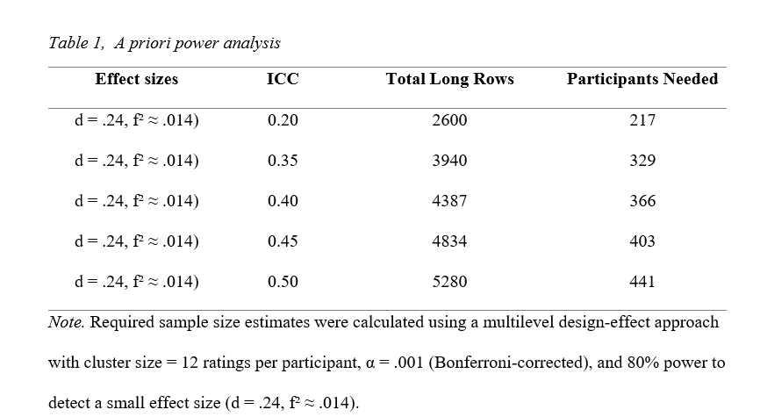
DATA COLLECTION CRITERIA

Slide 20
PROCEDURE
Informed Consent
Vignette Presentation (Randomized Order)
Post-Vignette Evaluations
trust, likeability, perceived trueness and positive attribution
Repeat step 2-3 for the other 5 vignettes
with attention check randomly presented in between
Demographics

Slide 21
Investigators = those who commit QRPs
Inspectors = those who report them
RESEARCH QUESTION 1
Research Question 1: How is trustworthiness influenced by role and QRP severity?
Hypothesis 1a: Inspectors will be rated as more trustworthy than investigators.
Hypothesis 1b: The relative trustworthiness of inspectors versus investigators will increase as QRP severity increases.

Slide 22
PLANNED ANALYSIS
Model 0: Yijk = γ000 + ν0k + μ0jk + εijk).
Model 1: Trust/Likeabilityijk = γ000 + γ100 (Researcherj) + ν0k + μ0jk + εijk
Model 2: Trust/Likeabilityijk = γ000 + γ010 (Severityk) + ν0k + μ0k + εijk
Model 3: Trust/Likeabilityijk = γ000 + γ100 (Researcherj) + γ010 (Severityk) + ν0k + μ0jk + εijk
Model 4: Trust/Likeabilityijk = γ000 + γ100 (Researcherj) + γ010 (Severityk) + γ110(Researcherj × Severityk) + ν0k + μ0jk + εijk

Slide 23
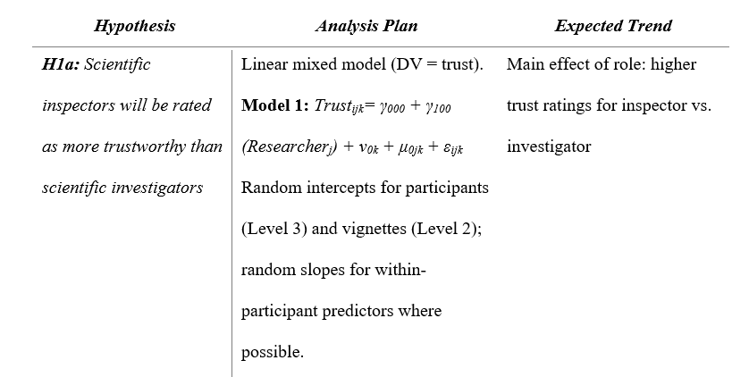
PLANNED ANALYSIS

Slide 24
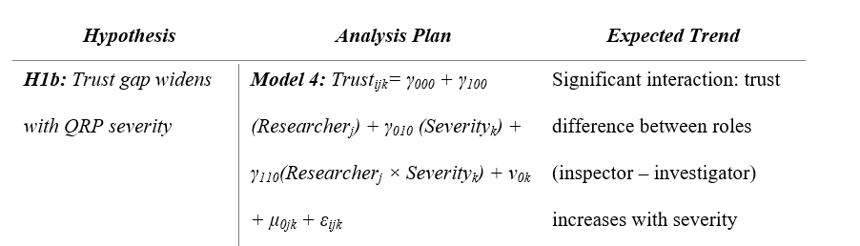
PLANNED ANALYSIS

Slide 25
Investigators = those who commit QRPs
Inspectors = those who report them
RESEARCH QUESTION 2
Research Question 2: How is likeability influenced by role and QRP severity?
Hypothesis 2a: Investigators will be rated more likable than inspectors.
Hypothesis 2b: At low QRP severity, investigators will be rated as more likeable than inspectors, but at high QRP severity, inspectors will be rated as more likeable than investigators.

Slide 26
PLANNED ANALYSIS
Model 0: Yijk = γ000 + ν0k + μ0jk + εijk).
Model 1: Trust/Likeabilityijk = γ000 + γ100 (Researcherj) + ν0k + μ0jk + εijk
Model 2: Trust/Likeabilityijk = γ000 + γ010 (Severityk) + ν0k + μ0k + εijk
Model 3: Trust/Likeabilityijk = γ000 + γ100 (Researcherj) + γ010 (Severityk) + ν0k + μ0jk + εijk
Model 4: Trust/Likeabilityijk = γ000 + γ100 (Researcherj) + γ010 (Severityk) + γ110(Researcherj × Severityk) + ν0k + μ0jk + εijk

Slide 27
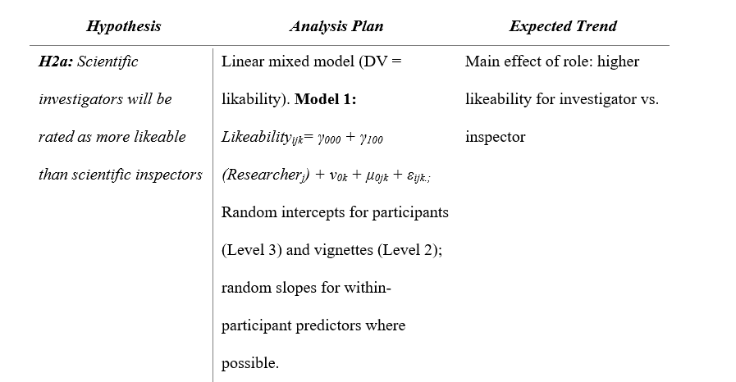
PLANNED ANALYSIS

Slide 28
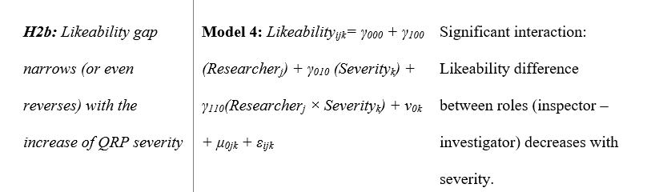
PLANNED ANALYSIS

Slide 29
Investigators = those who commit QRPs
Inspectors = those who report them
RESEARCH QUESTION 3
Research Question 3: Is the perceived trueness of the finding influenced by QRP severity?
Hypothesis 3: Perceived trueness will decrease as QRP severity increases.

Slide 30
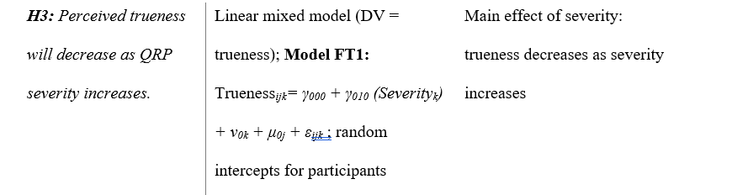
PLANNED ANALYSIS
Model FT1: Truenessijk= γ000 + γ010 (Severityk) + ν0k + μ0j + εijk

Slide 31
NOVELITY?
Understanding whistleblowing in science
Examines public perceptions of both those who commit QRPs (Investigators) and those who report them (Inspectors)
Explores the impact of severity on perceptions
Focuses more in depth on trustworthiness and likability
Notes:
First, it introduces a novel framework for examining scientific whistleblowing outside of industrial contexts. Second, it explores how the nature of the offense interacts with perceived roles to shape social judgments in science. In doing so, this work contributes to a more nuanced understanding of how ethical accountability is recognized and rewarded, or not, by the broader public. Lastly, this project was modeled from the Ebersole et al, 2016 paper and therefore I have included their scale of attributes to conduct an exploratory analysis. As the scientific community continues to emphasize transparency and responsible research practices, understanding the perceptions of scientific investigators and inspectors becomes crucial to fostering an environment where ethical accountability is supported rather than punished.

Slide 32
Prelim :)
THANK YOU
By Savannah C. Lewis

